Slide 1

CYBER ENRICH TRAINING PROGRAM | MODULE II
Federated Identity
DR.HITESH KUMAR SHARMA
Senior Associate Professor
Technical Instructor & Consultant

Slide 2
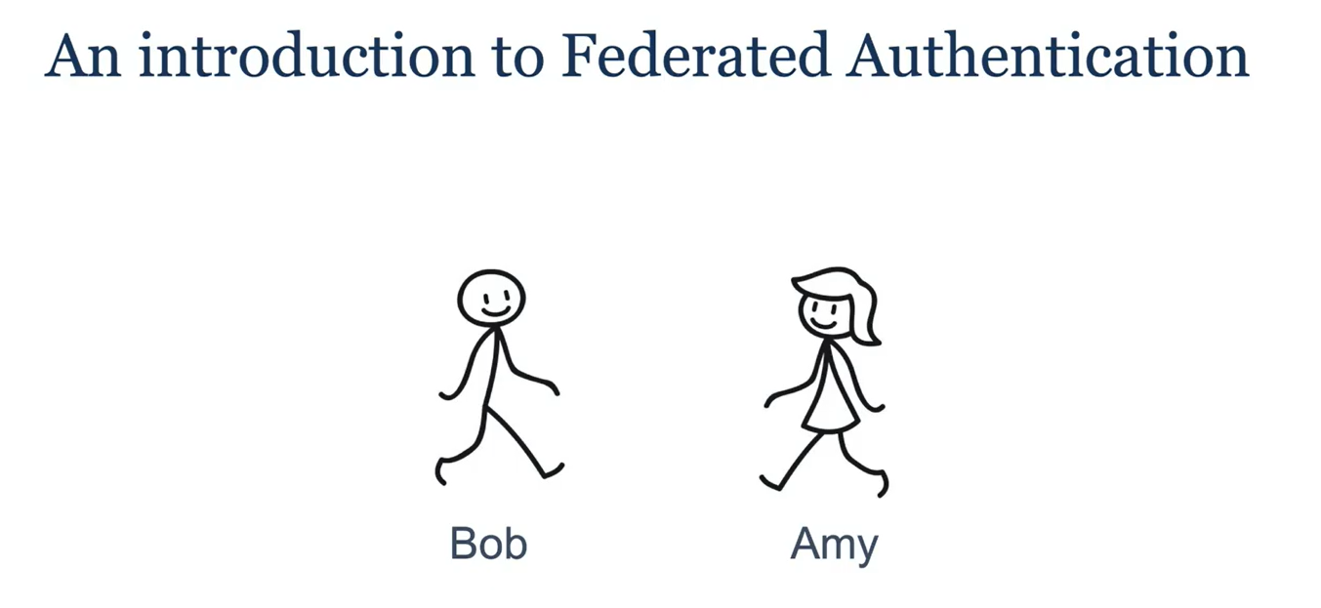

Slide 3


Slide 4
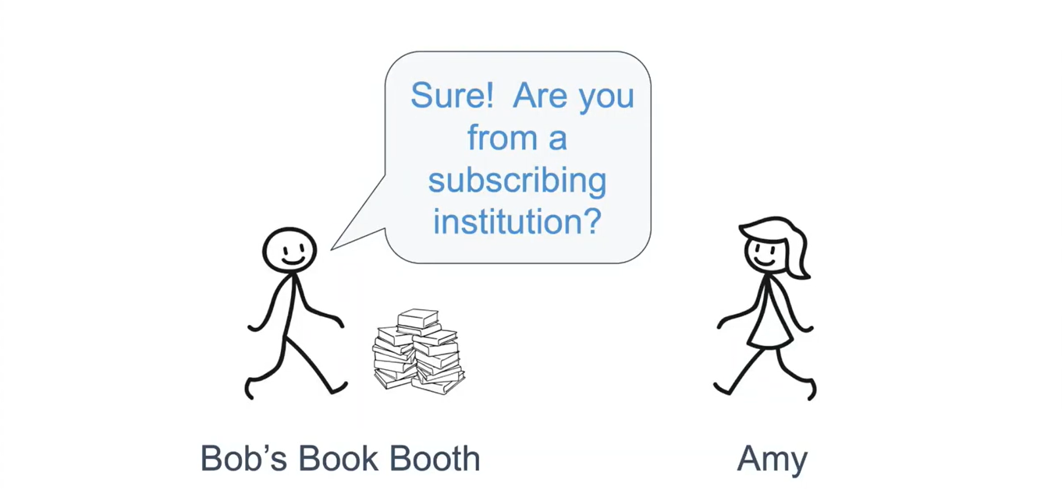

Slide 5


Slide 6
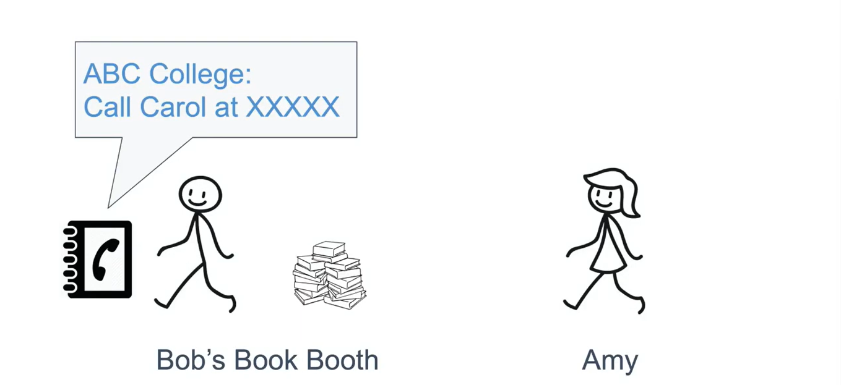

Slide 7
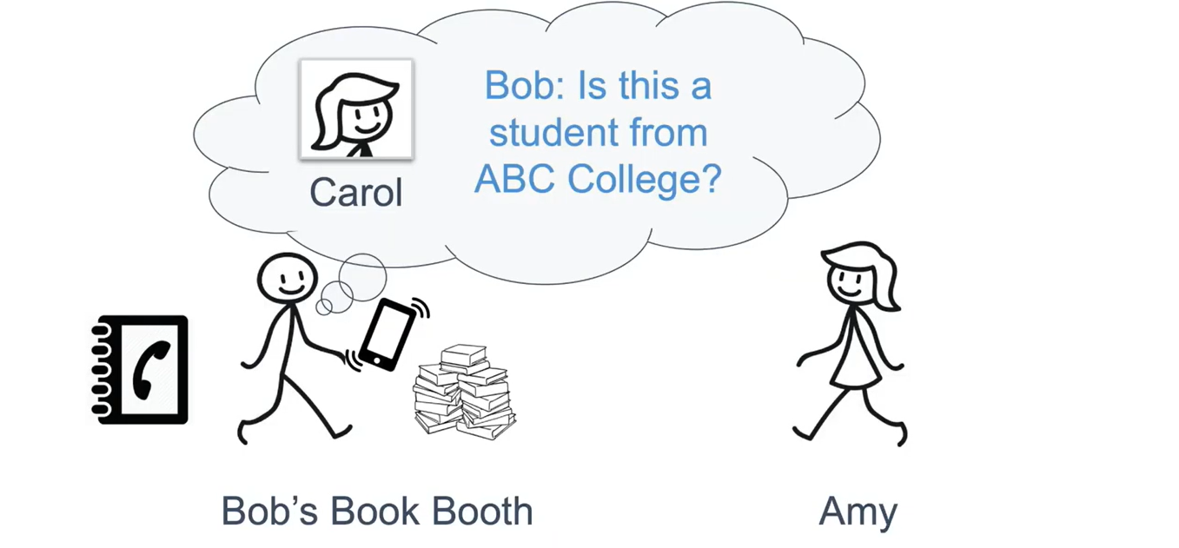

Slide 8
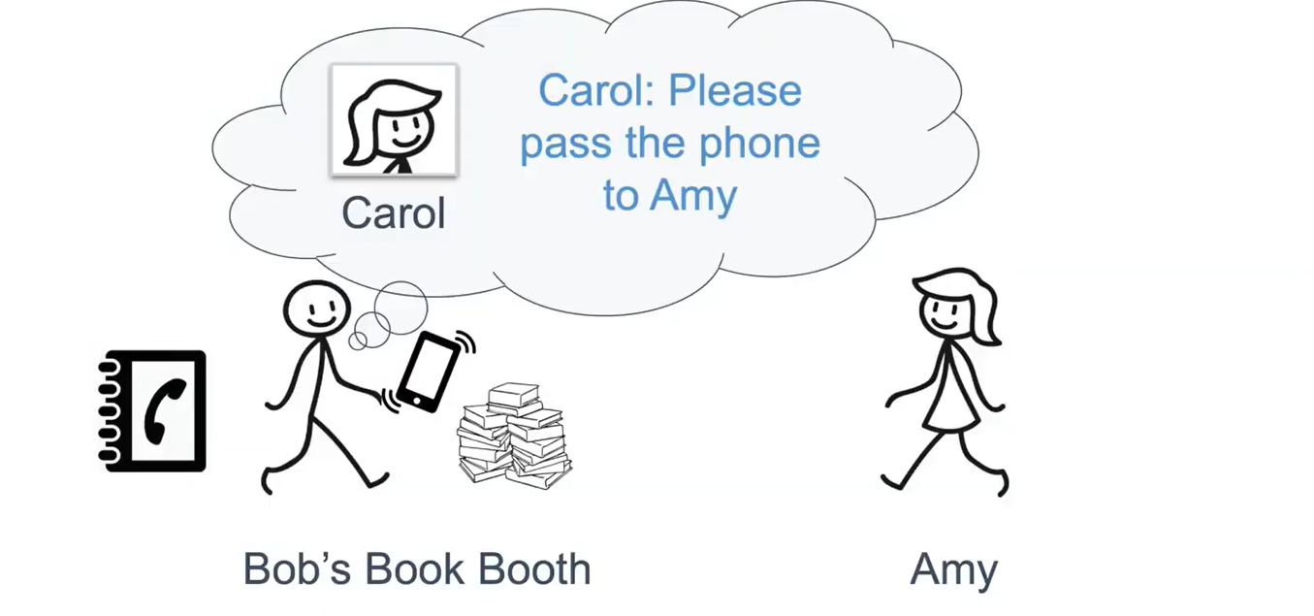

Slide 9
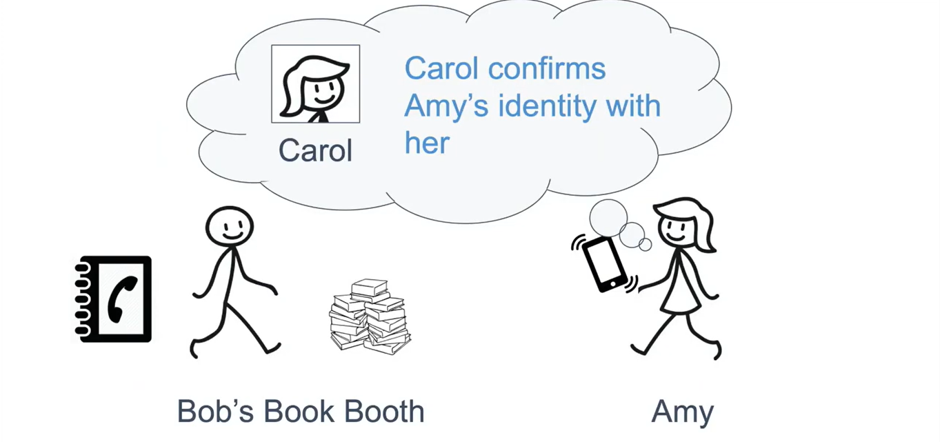

Slide 10
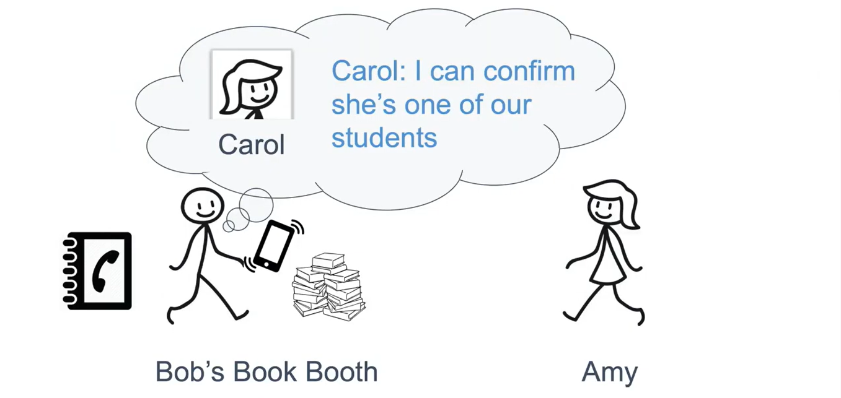

Slide 11
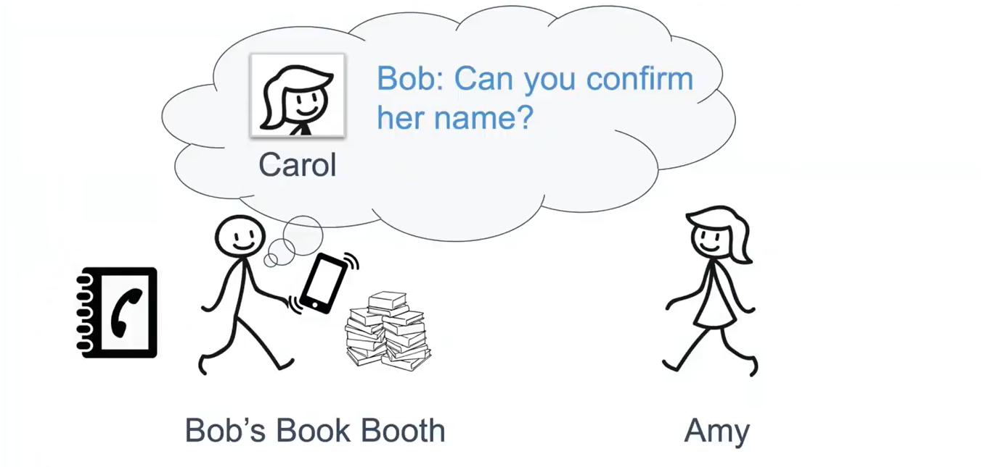

Slide 12
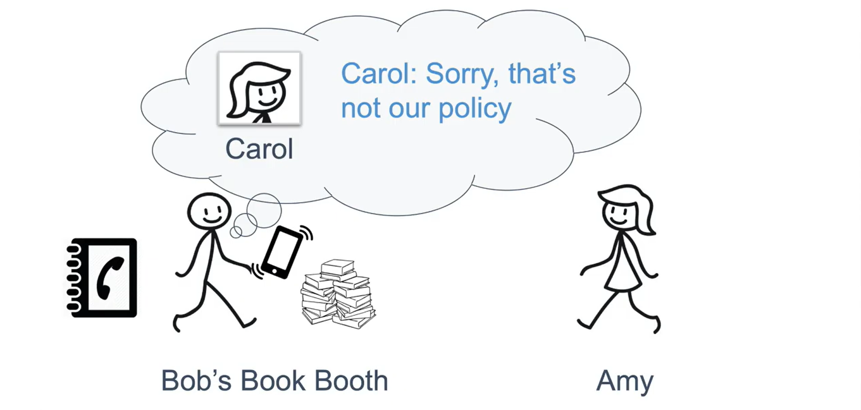

Slide 13
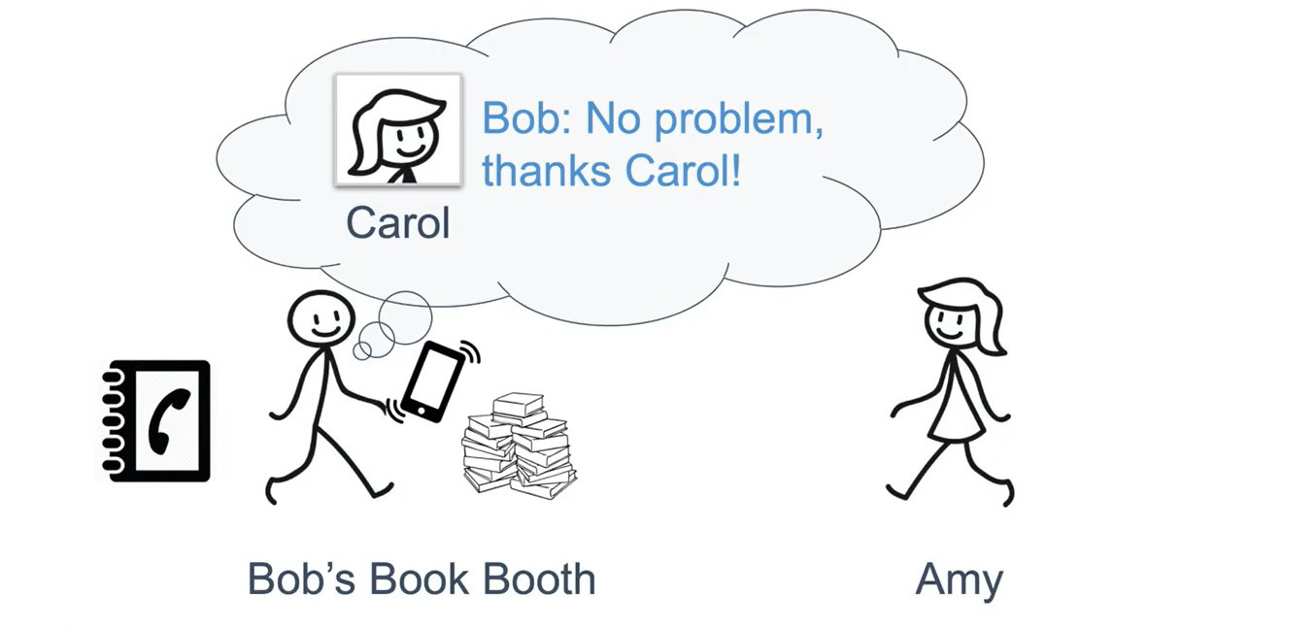

Slide 14
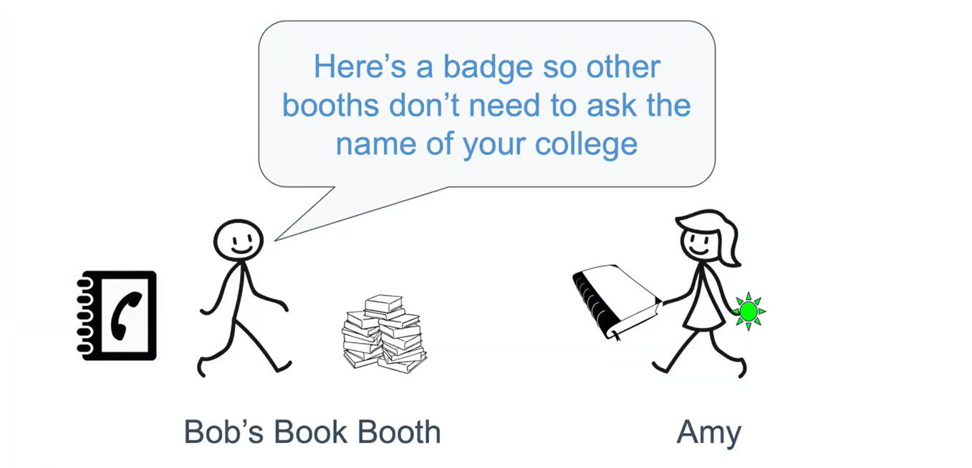

Slide 15


Slide 16
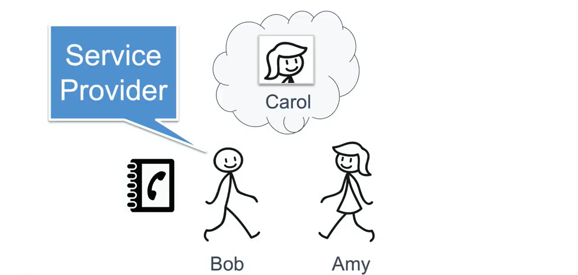

Slide 17
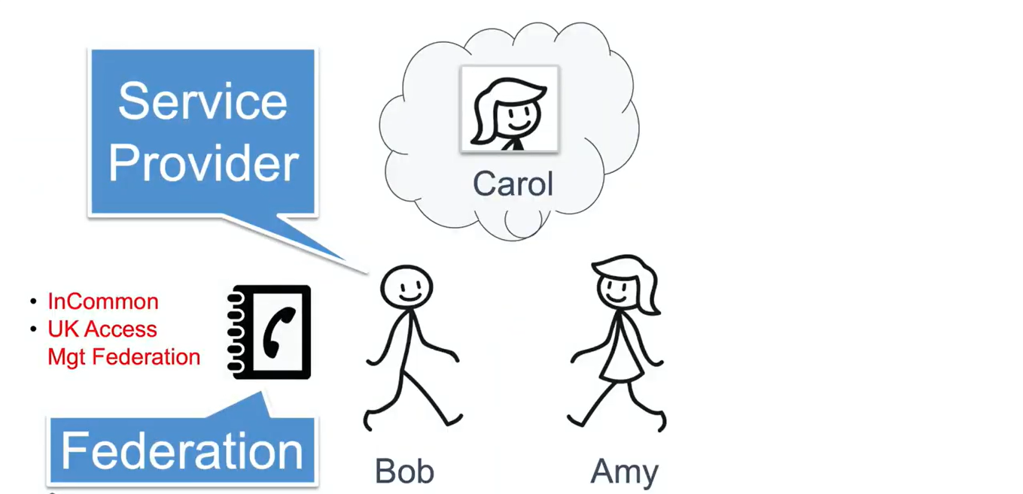

Slide 18
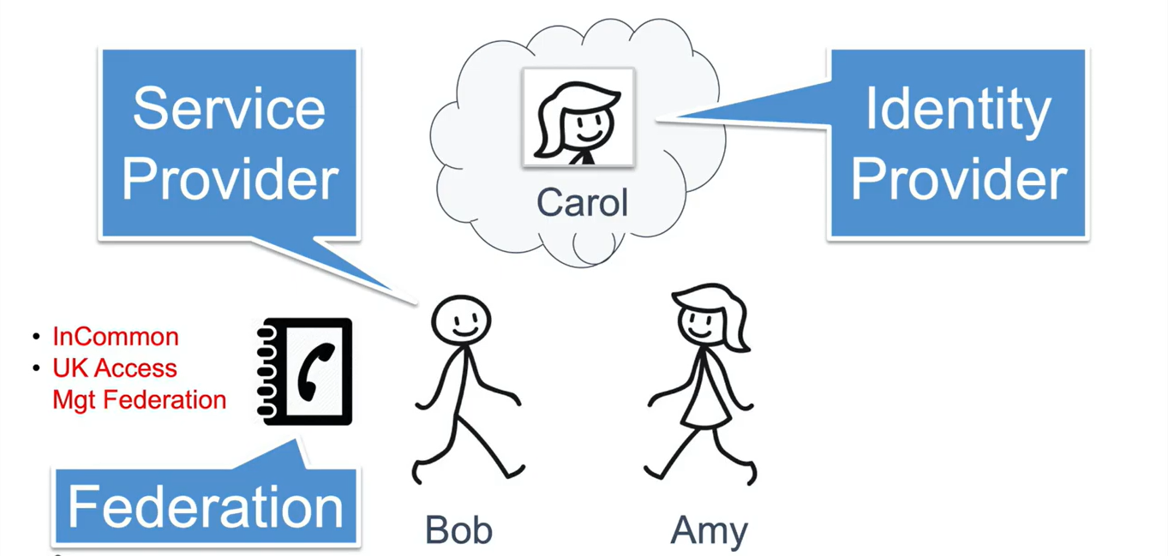

Slide 19
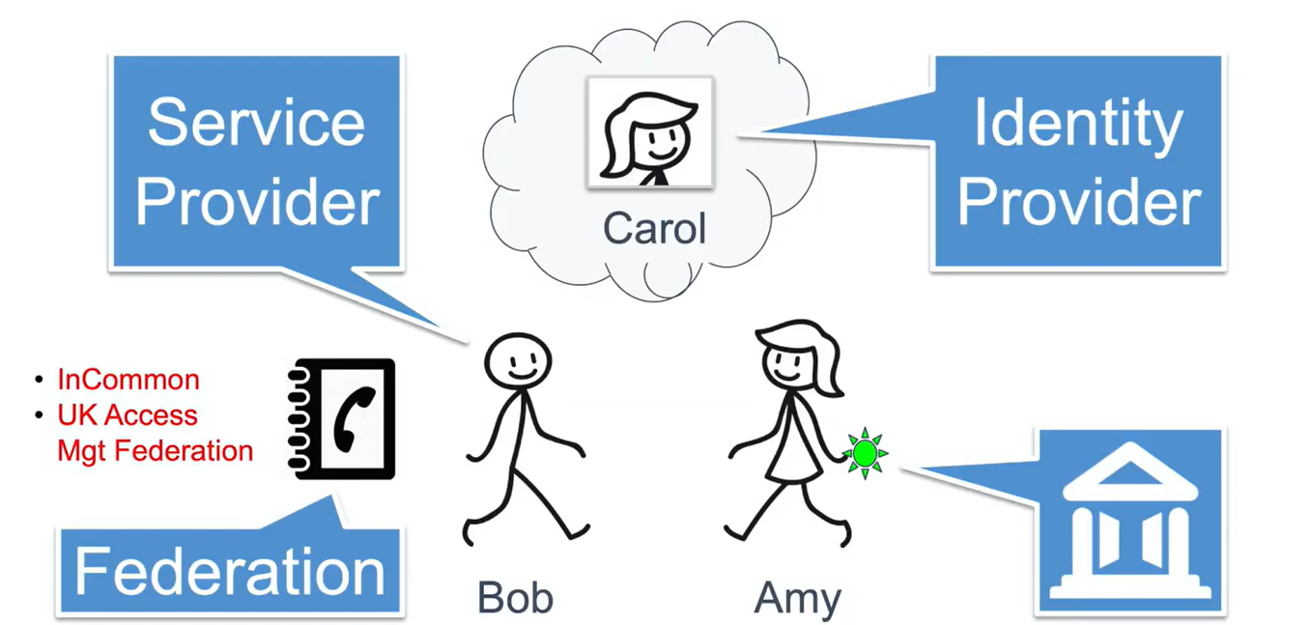

Slide 20
Benefits of Identity Federation
Provides a seamless user experience as users are required to remember only one set of credentials.
Single-sign-on is supported in most implementations.
Avoids administrative overheads by delegating account and password management responsibilities to the resident identity provider, instead of having to manage multiple identity silos.
Simplifies data management and storage costs.
Avoids privacy and compliance burdens.

